Slide 1
Payroll management system
Huzaifa Liaqat, Rayyan Lakhani, Ali Awais Safdar

Slide 2
synopsis
The code intended to make a payroll management system for two different kinds of employees, temporary and permanent.
Salary details varied for each type among the executable member functions as well.

Slide 3
structure
The code consists of one abstract base class, from which another abstract class is derived.
Two separate permanent/temporary classes inherit this derived class to implement polymorphism.

Slide 4
General details
The code implements file handling, giving the user the options to read, write and edit data of any employee type to a file.
Data assignment is done through complex constructor arrangement and const and static data members are both implemented.

Slide 5
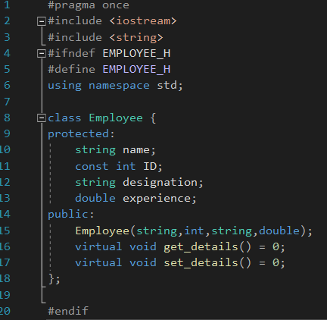
Employee class

Slide 6
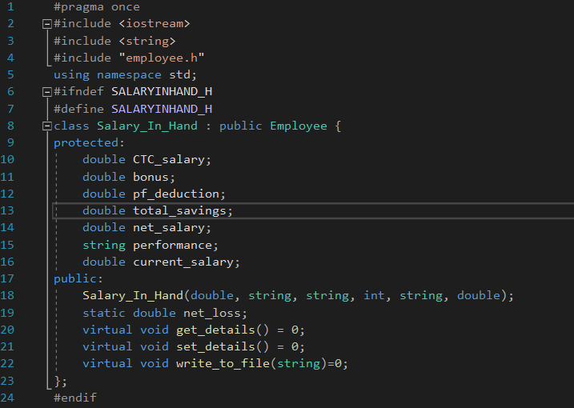
Salaryinhand class

Slide 7
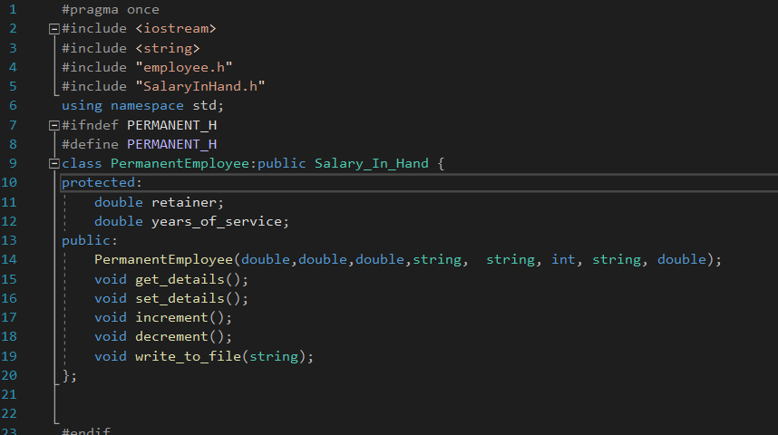
Permanent employee class

Slide 8
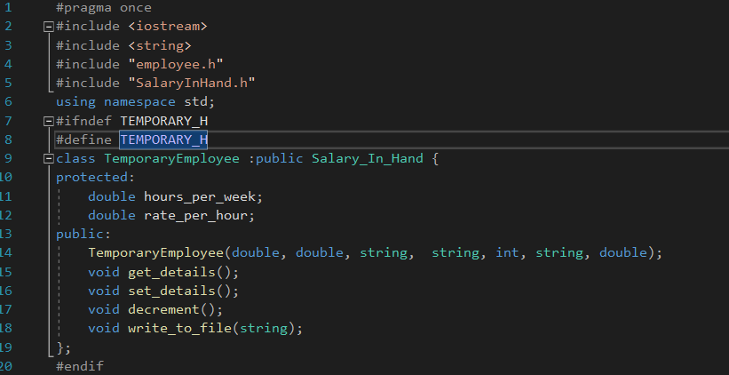
Temporary employee class

